Slide 1
Alone Together
(An aleatoric choral work for Zoom)
Instructions for conductor:
• This piece is for any number of singers, although smaller groups (6 or less) tend to work most effectively for Internet bandwidth.
• Each powerpoint slide gives a musical figure, which each singer will sing at their own time. There is no fixed pulse, and no singer should attempt to stay with any other.
• This powerpoint version of the piece gives the conductor the ability to change the music to fit the singers. In each subsequent slide, notes in blue can be dragged onto the staff, so that the pitches are chosen by you (or by your singers). It can be a fun activity to compose the piece together before performing it. On every slide with blue notes, in yellow below you will see the options of pitches you can choose from.
• No specific octaves are indicated; singers may sing the given pitch in whatever octave feels comfortable in their voice.
• A drone throughout can be helpful for tuning. Either the pitch ‘A’ may be used throughout, or moving drones as indicated in the blue boxes on each slide. Multiple people may play drones if desired.

Slide 2
Logistics and Technology
This piece is most easily performed by using a combination of Zoom and Powerpoint. Share your screen within the Zoom meeting with the choir, and then run the slideshow within Powerpoint. Singers are to move to each new box when the conductor changes the on-screen slide.
Zoom audio settings
For musical performance, the most effective audio settings are as follows: (make sure each singer/drone player sets their Zoom with these)
Go to Audio – Audio settings.
• Make sure that the microphone input volume is around half. (If the input level is too high, the audio will be prone to clipping.)
• Make sure that under microphone – “Automatically adjust volume” is OFF
• In the same menu, go to the “Advanced” tab.
Make sure “Show in-meeting option to “Enable Original Sound” from microphone is CHECKED on.
Make sure “Suppress Persistent background noise” is DISABLED.
Make sure “Suppress Intermittent background noise” is DISABLED.
• Going back to your meeting, make sure that in the top left of the window that you see a blue bar that reads “Turn off original sound.” (I.e. Original sound is ON for the meeting.)

Slide 3
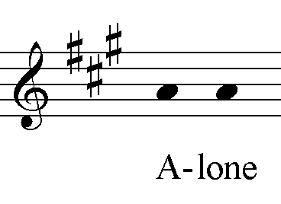
Drone: A

Slide 4
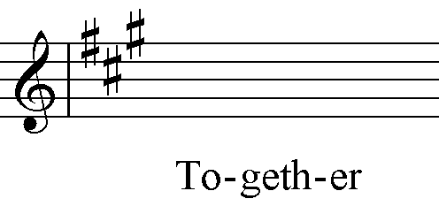
Choose pitches from:
Drone: A

Slide 5
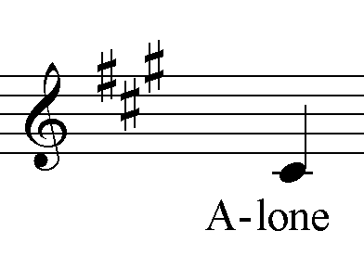
Choose pitches from:
Drone: A

Slide 6
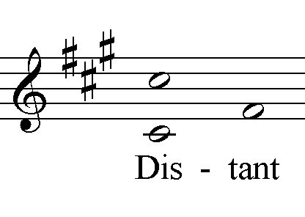
Drone: F# (or continue A)

Slide 7
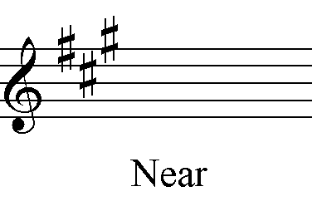
Choose pitches from:
Drone: F# (or continue A)

Slide 8
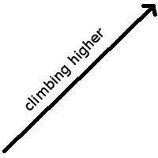
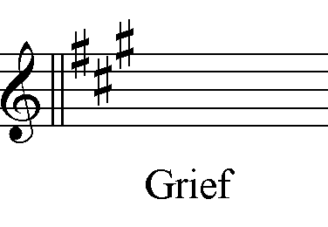
Optional – Delete slides 8-10 if desired
OR
Choose pitches from:
Drone: F# (or continue A)

Slide 9
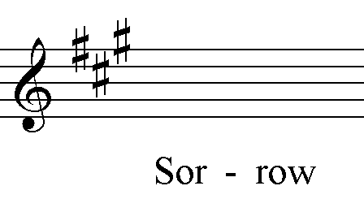
Optional – Delete slides 8-10 if desired
Choose pitches from:
Drone: F# (or continue A)

Slide 10
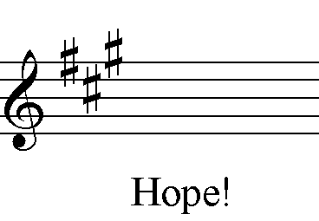
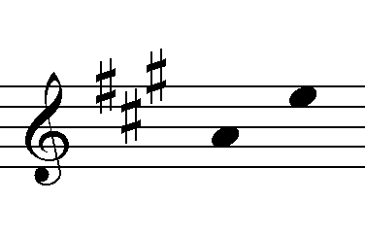
Optional – Delete slides 8-10 if desired
Choose pitches from:
Drone: D (or continue A)

Slide 11
Drone: D (or continue A)

Slide 12
Gradually drop out one
by one till only the drone remains.
Choose pitches from:
Drone: A

